Slide 1
FOREIGN ECONOMIC ACTIVITY OF UZBEK COMMODITY EXCHANGE JSC
2022, may

Slide 2
UZEX ELECTRONIC TRADING PLATFORMS
Public procurement
Internet trading
(B2B)
Online auction for car license plates
Electronic exchange
platform (highly liquid commodities)
Online auction for mobile numbers
Logistic portal

Slide 3
UZEX INFRASTRUCTURE
13 branches in regional centers
322 trading pits, including 19 overseas offices
more than 1 600 sellers of goods
1 156 brokerage houses and 3 135 traders
client base - more than 290 thousand

Slide 4
DAILY INDICATORS
more than 5 thousand transactions amounted 30 million US dollars
8 500 transactions the amounted 40 million US dollars
about 150 new clients
more than new 60 standard contracts
Software solutions (listing, clearing,trading, analytics, etc )
Interactive services (via personal account)
More than
20
Call center
10
24/7

Slide 5
ACCREDITED FOREIGN CLIENTS
more than - 3000, including:
Kazakhstan | 1011
Russia | 318
Kyrgyzstan | 342
Tajikistan | 192
Afghanistan | 172
Turkey | 104
Ukraine | 50
Belarus | 33
Great Britain | 113
China | 119
UAE | 60
Turkmenistan | 15
Other | more than 450

Slide 6
OVERSEAS OFFICES
A total of 23, including
Kazakhstan | 6
Russia | 6
Kyrgyzstan | 2
Ukraine | 2
China | 2
Belarus | 1
Tajikistan | 1
Latvia | 1
Poland | 1
Azerbaijan | 1

Slide 7
OVERSEAS BROKERAGE FIRMS
A total of 26, including
Kazakhstan | 12
Russia | 4
Kyrgyzstan | 3
Ukraine | 2
Latvia | 2
Belarus | 1
Tajikistan | 1
Poland | 1

Slide 8
TRADED COMMODITIES
1. Automobile gasoline. 2. Extraction gasoline
3. Diesel oil
4. Technical kerosene.
5. Polypropylene
6. Polyethylene
7. Sulfur technical
8. Coal
9. Mineral fertilizers
10. Soda ash
11. Copper cathode. 12. Copper rod
13. Aluminum
14. Ferrous metals. 15. Zinc
16. Cement
17. Cement clinker
18. Building glass
19. Sugar
20. Wheat
21. Barley
22. Cotton-fiber 23. Cotton-linter
24. Cottonseed oil
25. Cottonseed hull
26. Cottonseed cakes
27. Technical cotton seeds
28. Technical oils 29. Heating oil
30. Wheat flour.
31. Compound feed
32. Fuel oil
33. Liquefied gas.
34. Laundry soap.
35. Petroleum solvent.
36. Paraffin.
37. Petroleum bitumen.
38. Copper sulfate.
39. Oil
40. Gas condensate
41. Polyvinyl Chloride
42. Formalin
43. Ethyl alcohol
44. Extraction oil (cotton)
45. Silver

Slide 9
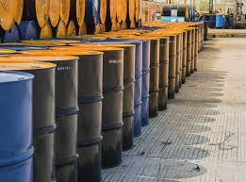
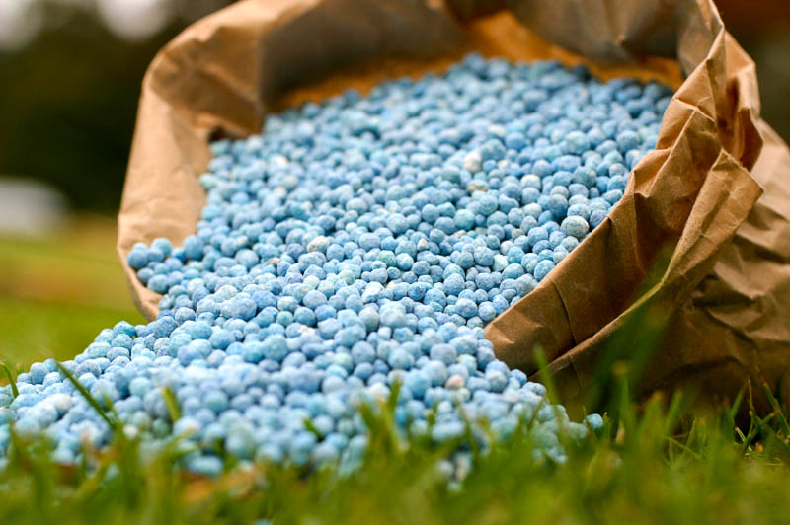
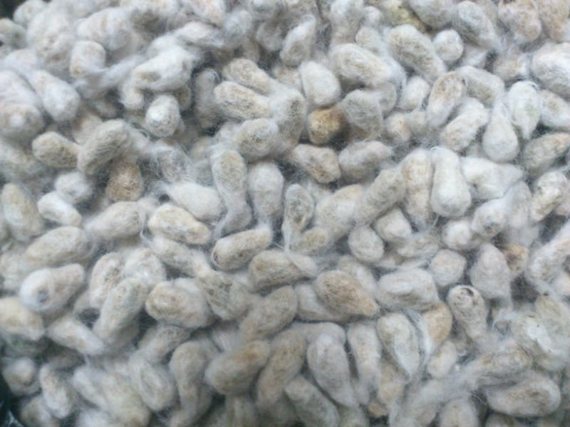
MAIN SEGMENTS
Oil products
Cotton fiber
Cement
Fertilizers
Nonferrous metals
Seeds

Slide 10
DYNAMICS OF COMMODITY TURNOVER OF THE EXCHANGE PLATFORM
MILLION USD

Slide 11
FOREIGN PARTNERS
Kazakhstan | Commodity exchange «ЕТС»
Belarus | «Belarusian Universal Commodity Exchange»
Russian Federation | «Saint Petersburg International Mercantile Exchange» «Moscow Stock Exchange»
Turkmenistan | State Commodity and Raw Materials Exchange of Turkmenistan "GTSBT“
Kyrgyzstan | JSC «Kyrgyz Stock Exchange»

Slide 12
INTERNATIONAL ORGANIZATIONS
International association of exchanges of countries (IAE) | Full membership
Association of Futures Markets (AFM) | Full membership
Federation of Euro-Asian stock exchanges (FEAS) | Full membership

Slide 13
THE EXCHANGE TRADING PLATFORM

Slide 14
ACCREDITATION OF FOREIGN CLIENTS
Statement;
Copy of the director's passport;
A copy of the agreement with the brokerage office for the provision of brokerage services.
All documents are reviewed within 1 business day, as a result:
a settlement and clearing agreement has been concluded;
a personal account is opened in RCP (INP-individual user number);
access to your personal account is provided (login-password).

Slide 15
UZEX Server
Internet gateway with a static dedicated IP address of the user's provider
Internet
UZEX Trading platform
Remote users (bidders)

Slide 16
OVERSEAS OFFICES FEATURES
Accreditation of new clients
Launching new contracts
Registration of a trade transaction

Slide 17
BENEFITS FOR FOREIGN CLIENTS
Direct access to the traded commodities
All exchange transactions are carried out through the оverseas offices
Access to information on the demand / supply for commodities in Uzbekistan
Official document flow is carried out through the оverseas offices

Slide 18
THE SETTLEMENT AND CLEARING CHAMBER:
OPERATING PROCEDURE

Slide 19
UZEX TRADING MECHANISM
Seller
1. UZEX commissions
Clearing chamber
1. UZEX commissions
Buyer
3. Access
to trades
2. Buy order
2. Sale order
Trading system
Seller’s Broker
4. Puts commodity
for sale
Buyer’s
broker
5. Purchase commodities

Slide 20
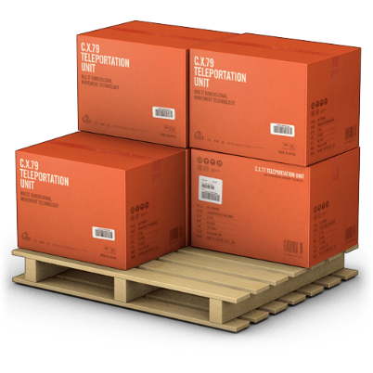
CALCULATIONS
2. Payment
confirmation
1. 100% payment under the contract
Seller
Clearing chamber
Buyer
3. Commodity shipment
4. Shipping documents provided to Clearing chamber
5. Clearing transfers funds to the seller's bank

Slide 21
BENEFITS PROVIDED TO SUPPLIERS FOR CERTAIN TYPES OF GOODS
In accordance with the Decree of the President of the Republic of Uzbekistan dated March 17, 2021 No. PP-5031, internal tariffs are applied for the transportation by rail of goods that are in high demand in the domestic market, including flour, wheat, sugar, vegetable oil, polyethylene, polypropylene, cement, liquefied gas, rapeseed (seeds, meal, cake, oil), sunflower (seeds, meal, cake, oil), soybeans (seeds, meal, cake , oils), fishmeal and oil, barley, corn, phosphate (tricalcium, monocalcium, dicalcium), choline chloride, as well as high demand products based on commodity market analysis.

Slide 22
BENEFITS PROVIDED TO SUPPLIERS FOR CERTAIN TYPES OF GOODS
In accordance with Protocol No. 81 of October 16, 2020, a video conference call chaired by the President of the Republic of Uzbekistan Sh.M. Mirziyoyev "On measures to ensure food security and price stability in the domestic market" (paragraph 11).
The protocol instructs the State Customs Committee to ensure the calculation of customs payments for transactions concluded through foreign trading pits of the exchange, based on the prices indicated in these transactions.

Slide 23
BENEFITS PROVIDED TO NON-RESIDENT SUPPLIER OF PRODUCTS
In order to create additional convenient and modern conditions for non-residents - suppliers of goods, JSC "UZEX" decided in a simplified procedure for accreditation of non-resident customers, including without prior deposit of funds in the settlement - clearing branch.
The minimum requirements for the opening of foreign trading platforms have also been approved, simplifying the procedure for their accreditation.
In addition, from July 1, 2022, the commission fee for organizing an exchange transaction, as well as the commission fee for settlement - clearing branch services, will not be charged from non-resident suppliers and there will also be no collateral for the transaction.

Slide 24
Uzbek Commodity Exchange Uzbekistan, 100090 Tashkent, st. Bobur, 77 Tel. / Fax: (+998 71) 207-00-33 E-mail: info@rtsb.uz www.uzex.uz
www.uzex.uz

