Slide 1
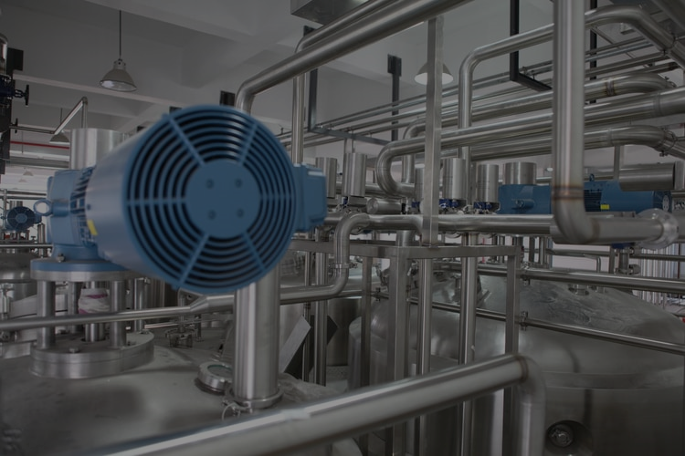
Keep on Spinning !
Product presentation

Slide 2
Table of contents
1| About us
2| Product range
3| Cyclofan DB10
4| Specifications
5| Advantages
6| Contacts

Slide 3
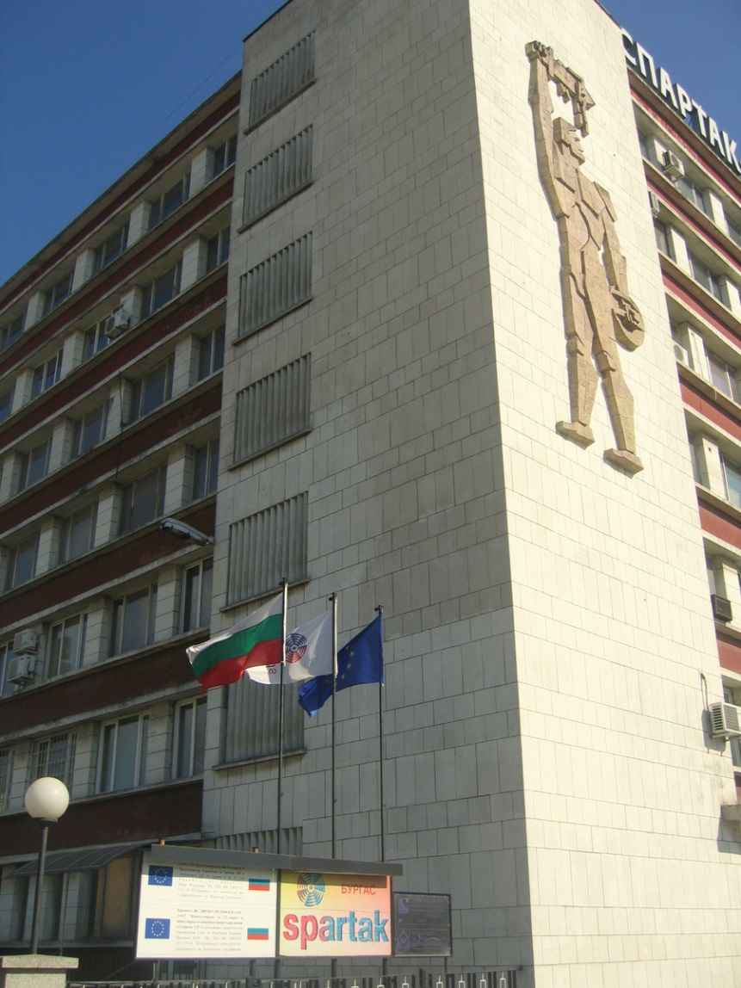
1|About us
Founded in 1928, Spartak JSC is specialized in the production of industrial fans and steel metal works for more than 80 years
Situated in the Western Industrial Zone in Burgas, Bulgaria with easy access to sea, land and air transport
Current number of employees - 84
The company’s working site (around 14 000 m²) allows for higher production rates
Over 80% of our production is exported to clients in Western Europe and Russia

Slide 4
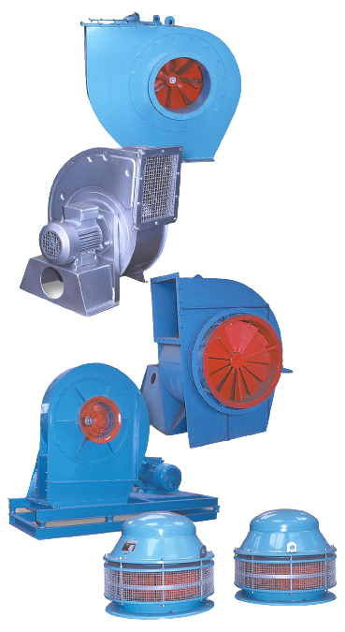
2|Product range
Spartak JSC is a Bulgarian manufacturer of industrial and domestic fans.
Our fans have the following applications:
for the ventilation and climatization of houses, public , production and other buildings;
for the transportation of granulated and powdered products such as a flour, grain, cement, saw-dust, shavings, etc.;
for the delivery of air flow in the combustible and other technological processes;
in the freezing and drying plants;
in the technological processes of mining, metallurgic and chemical industry, power plants and agriculture.

Slide 5
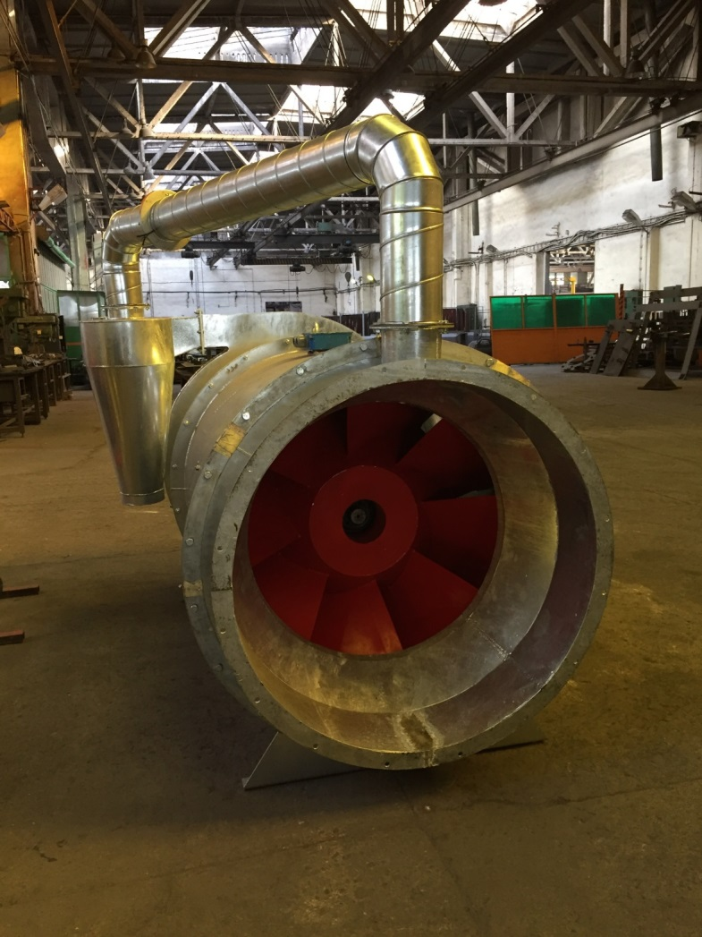
3| Cyclofan DB10
Product description
The newest addition to our product range is the Cyclofan DB10:
The Cyclofan DB10 dust extraction unit, powered by a 30kW engine, is intended to separate dust from contaminated air in grain drying.
The dust extraction is achieved by centrifugal force pushing dust particles to the outside of the casing;
We have designed this fan to suit the needs of agriculture, especially for grain drying;
Ensures efficient filtering of grains and other cereals up to 95%.

Slide 6
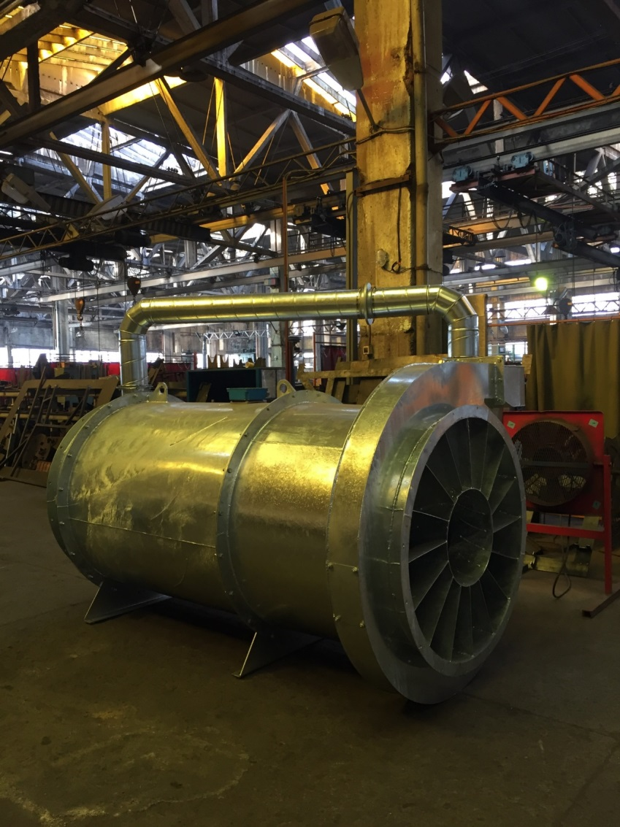
4| Specifications
Fan data
Volume Q = 16000 - 49000 m³ / h;
Static pressure H = 2020 - 645 Pa;
Engine - 30 kW / 1500 min-1; 380V; IP 54;
Size of the connecting flange - Ø 1070;
- Area of the inlet section of the fan - 0.515 m²;
- Area of the outlet section of the fan - 0.695 m²;
- Speed of rotation of the impeller - 1400 min-1;
Hot dip galvanized casing;
Wet painted impeller.

Slide 7
4| Specifications
Dimensions

Slide 8
4| Specifications
Flow rate capacities

Slide 9
5| Advantages
The advantages of our Cyclofan DB10 include:
A combination of advantages of centrifugal and axial fan which provides for the high air volume and low pressure performance;
Competitive market price;
Customizable - additional silencers and/or an ATEX engine can be added, according to customer specifications;
Flexible and fast production time – up to 4 weeks.

Slide 10
Keep on Spinning !
“Spartak” JSC
3, Odrin Str, 8000
Burgas, Bulgaria
For more information and inquiries:
Website: www.spartak.bg
Telephone: +359 56/880 080
+359 56/831 554
Fax: +359 56/831 553
Email: spartak@spartak.bg
Thank you for the attention !

