Slide 1
ÖKOINDUSTRIA 2020
International Green Expo

Slide 2
Exhibition Info
ÖKOINDUSTRIA is a leading international green economy expo in Central Europe for environmental technologies, products and services with special focus on brownfield industry, waste management, circular economy and green education.
Date: 4-6 November 2020
Venue: Budapest, Millenáris Park, Hall B
Figures of the last 5 editions of ÖKOINDUSTRIA
15000
79
580
Visitors
Conferences
Exhibitors
Notes:
Több diára is szükség lehet

Slide 3
About the organizer HAEE (Hungarian Association of Environmental Enterprises)
At present, we have 240 member companies, which are important economic organisations of the Hungarian eco-industry. The members of the Association observe and enforce the local, regional and global goals, principles and priorities of environment and nature protection.
They promote protecting biodiversity, achieving the goals of climate policy, conserving natural resources, implementing circular economy, waste hierarchy, economical and effective usage of materials, energy and sustainable development of livable environment.
We help improve environmental processes and activities both at national and international level, with special regard to the Carpathian Basin, The Danube River Catchment Area and the V4 cooperation. As a non-profit organization, it provides information to all interested parties on the possibilities of solving environmental tasks and the activities of specialized companies. We currently have 230 members.
As a representative of professional interests, the Association is a valued expert partner of the national legislation, preparatory bodies, and requests statuary interpretations and resolutions for the specific demands of its members.
The ÖKOINDUSTRIA International Green Exhibition is organized traditionally every second year by the Association, the concept itself launched in 2009
Notes:
Több diára is szükség lehet

Slide 4
Patrons, sponsors and partners
Main patron: H.E. János Áder President of Hungary
Patrons: under request: István Nagy, Minister of Agriculture
László Palkovics, Minister for Innovation and Technology and Sándor Pintér (Minister of Interior)
Main sponsors: Ministry for Innovation and Technology
Blue Planet Climate Protection Foundation
Bálint Analitika Ltd.
Partners: Expodom Ltd.
Appearances so far: Budapest Water Summit: 15-17 October 2019, Aquatech Amsterdam: 5-8 November 2019
Notes:
Több diára is szükség lehet

Slide 5
Short image films from earlier editions
10 mp
2 perc
https://youtu.be/rGgT8hke4Mk

Slide 6
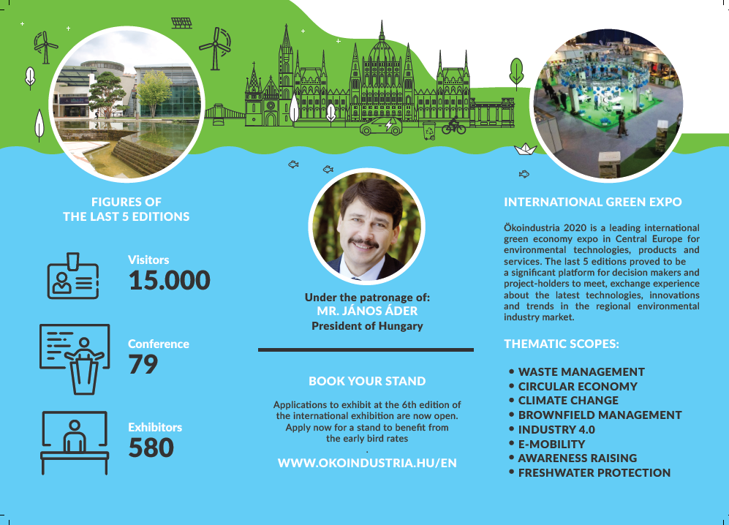
Image and leaflet (English and Hungarian) Catalogue and magazine attachment

Slide 7
Aims of the Expo
Our main aim is to elevate ÖKOINDUSTRIA to a higher international level and steer the focus on the environmental issues in the Central and Eastern European region
During the three days of the event providing a platform to
strengthen the Carpathian Basin cooperation by crossborder projects
HIGHLIGHT: keynote speakers from outstanding actors of the industry and invite a COUNTRY OF HONOUR to share knowledge, boost communication and debates about the most actual questions
meet and exchange experience for decision makers and project-holders about the latest state-of-the-art technologies and ecoinnovations, cooperations and investing opportunities, trends in the regional environmental industry market
enhance professional networking.
DRAFT DAILY PROGRAMME
4 November: business day; opening ceremony, international delegations, VIP innovation tours, award ceremonies (incl.ÖKOINDUSTRIA Grand Prize), reception for the exhibitors and the invited persons
5 November: open for business and public
6 November: open day also for schools, career opportunities for the next generations, special programs of raising awarness of environmental protection will be focusing on teachers, professors and university students as well
Notes:
Több diára is szükség lehet

Slide 8
Exhibition sectors
Thematic scopes
Circular economy, brownfield industry, waste management
Ecoinnovations in Hungary, start-up market, ”green” job fair (GINOP-5.3.5-18-2018-00020)
Green mobility, energy efficiency, renewable energy
Protection of fresh waters, water- and waste water treatment
Raising awareness, education for sustainability.
Water- and waste water treatment
E-mobility (In coooperation with IFKA)
Climate, air-, noise-, and vibration
Waste management
Awareness raising, Media
Renewable energy
Governmental bodies (ministries, embassies)
NGOs (national parks, trade associations, civil organisations)

Slide 9
Target groups- exhibitors and visitors
Hungarian environmental companies, organisations
International environmental companies, governmental and non-governmental organisations (Embassies of Netherlands, India, USA, UK, Canada)
Leaders/representatives of international organisations
Ministries, municipalities
Civil organisations
Universities and colleges offering education and diploma for environmental engineers
Companies offering carreers in green industry
Students
Media
General public devoted to the environmental industry
Notes:
Több diára is szükség lehet

Slide 10
Side events under preparation - DRAFT
Remediation and brownfield management conference
Sustainability Summit
ISWA, NICOLE, EWA member meeting
B2B meetings
Start-up market
Green industry labor market 2020 conference – supply, demand, competences, trends
Project closing half day conferences: Coca Cola and IBB
ECOCafé – paneltalks: case studies, best practice project and investment presentations
Green Movie (Presenting awarded winner films of the International Nature Film Festival Gödöllő)
Eco playground
Thematical site visits, tours
Reception and ÖKOINDUSTRIA Grand Prize ceremony
Notes:
Több diára is szükség lehet

Slide 11
ÖKOINDUSTRIA 2017
Side events in 2017: https://okoindustria.hu/en/side-events
Exhibitors in 2017: https://okoindustria.hu/en/our-exhibitors
In 2017 we had the honour to host the annual ISWA conference in Budapest during the exhibition as well as the award ceremony of EBAE (European Business Awards for the Environment) which contributed greatly to the event’s recognition.
In 2020 we would like to go beyond and extend the international scope of the exhibition.
Notes:
Több diára is szükség lehet

Slide 12
Organising team
Gary Hankó
project manager
Zoltán Toronyi sales manager
Csaba Markó programme manager
Anna Istenes
event management, international relations
Piroska Bedő communications manager
András Pál
Website, online applications
Julianna Abdelli invoicing, finance
Tamás Freyberger back-office, catalogue entries

Slide 13
„Spreading the word...-Advertising the expo”
Members of the Association, professional network of the Association beyond members
Embassies of Hungary abroad, foreign economic attaches,
Embassies in Hungary (for e.g. Netherlands, Canada, India, Italy, France, USA, UK, .. )
HEPA, CED strategic partnership
KEXPORT Cluster V4 cluster cooperations and international relations
Integrating IFKA’s e-mobility visitor center into the exhibition in Millenáris
Mediapartners
Notes:
Több diára is szükség lehet

